Slide 1

DEliVERiNGSKiLLS
DRiViNGSUCCESS
www.VINSYS.COM

Slide 2
Database Actors
Database Administrators
In a database environment, the primary resource is the database itself and the secondary resource is the DBMS and related software
authorizing access to the database
coordinating and monitoring its use
acquiring software and hardware resources as needed
Database Designers
identifying the data to be stored in the database
choosing appropriate structures to represent and store this data undertaken before the database is actually implemented and populated with data

Slide 3
Database Actors …..
communicate with all prospective database users, in order to understand their requirements
develop a view of the database that meets the data and processing requirements for each group of users
These views are then analyzed and integrated with the views of other user groups. The final database design must be capable of supporting the requirements of all user groups
End Users
access to the database for querying, updating, and generating reports
Casual end users:
occasionally access the database
need different information each time
learn only a few facilities that they may use repeatedly.

Slide 4
Database Actors …..
use a sophisticated database query language to specify their requests
typically middle- or high-level managers or other occasional browsers
Naive or parametric end users
constantly querying and updating the database, using standard types of queries and updates called canned transactions that have been carefully programmed and tested
need to learn very little about the facilities provided by the DBMS
Bank tellers check account balances and post withdrawals and deposits
Reservation clerks for airlines, hotels, and car rental companies check availability for a given request and make reservations
Clerks at receiving stations for courier mail enter package identifications via bar codes and descriptive information through buttons to update a central database of received and in-transit packages

Slide 5
Database Actors …..
Sophisticated end users
Engineers, scientists, business analysts, and others who thoroughly familiarize themselves with the facilities of the DBMS so as to implement their applications to meet their complex requirements
Try to learn most of the DBMS facilities in order to achieve their complex requirements
Stand-alone users
Maintain personal databases by using ready-made program packages that provide easy-to-use menu- or graphics-based interfaces. An example is the user of a tax package that stores a variety of personal financial data for tax purposes
Typically become very proficient in using a specific software package

Slide 6
Database Actors …..
System Analysts and Application Programmers
Determine the requirements of end users, especially naive and parametric end users, and develop specifications for canned transactions that meet these requirements
Application programmers implement these specifications as programs; then they test, debug, document, and maintain these canned transactions
Workers behind the Scene
Typically do not use the database for their own purposes
DBMS system designers and implementers
design and implement the DBMS modules (for implementing the catalog, query language, interface processors, data access, concurrency control, recovery, and security. ) and interfaces as a software package

Slide 7
Database Actors …..
Tool developers
Tools are optional packages that are often purchased separately
include packages for database design, performance monitoring, natural language or graphical interfaces, prototyping, simulation, and test data generation.
Operators and maintenance personnel
system administration personnel who are responsible for the actual running and maintenance of the hardware and software environment for the database system

Slide 8
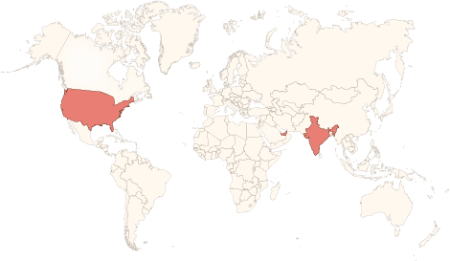






Physical Presence
www.vinsys.com
enquiry@vinsys.com
Shivaji Niketan, Tejas Society, Behind Kothrud Bus Stand, Near Mantri Park, Kothrud, Pune - 411029.
304, City Tower 2, Near Crown Plaza, Sheikh Zayed Road. Dubai, UAE.
PO.Box - 213279
132 West 31st Street, First Floor, New York, 10001, USA

